Slide 1
YOUTUBE TRENDING VIDEO ANALYSIS & MACHINE LEARNING MODEL
by Shaba Farheen

Slide 2
OVERVIEW
Analyzed YouTube trending video data to uncover patterns in views, categories, tags, and upload trends. Built a machine learning model to predict video popularity based on key features. This project showcases data cleaning, visualization, feature engineering, and predictive modeling.

Slide 3
PROBLEM STATEMENT
The YouTube Trending Videos dataset contains daily records of videos that reached the trending list across different categories.
However, raw trending data alone does not provide clear insights into:
What type of content trends the most
Which categories dominate the trending page
How views, likes, comments, and engagement vary
Whether some days get higher trending activity
Trends in user interaction (likes/dislikes/comments)
The challenge is to analyze category-wise performance, engagement metrics, daily patterns, and creator trends to help marketers, creators, and analysts understand what drives content virality on YouTube.
This project aims to uncover viewership patterns, engagement behaviour, category strengths, and factors contributing to trending videos.

Slide 4
Task 1 - Data Preprocessing & Feature Engineerings
1.1 Data Loading
✔ Imported the dataset in Jupyter Notebook using Pandas:
df = pd.read_csv("USvideos.csv")
1.2 Data Cleaning
✔ Checked missing values
✔ Dropped unnecessary or duplicate columns
✔ Converted trending_date to datetime format
✔ Cleaned text fields (title, description, tags)
✔ Handled incorrect datatypes
1.3 Feature Engineering
Created new columns:
✔ day_of_week → Extracted from trending date
✔ title_length → Character count
✔ tags_count → Number of tags
✔ engagement_rate →
(df['likes'] + df['comment_count']) / df['views']
✔ like_dislike_ratio

Slide 5
Task 2 — Exploratory Data Analysis (EDA)
Performed analysis on:
✔ Trending frequency by day of week
✔ Most popular video categories
✔ View distribution
✔ Like & comment patterns
✔ Creator-wise analysis
✔ Engagement distribution across categories

Slide 6
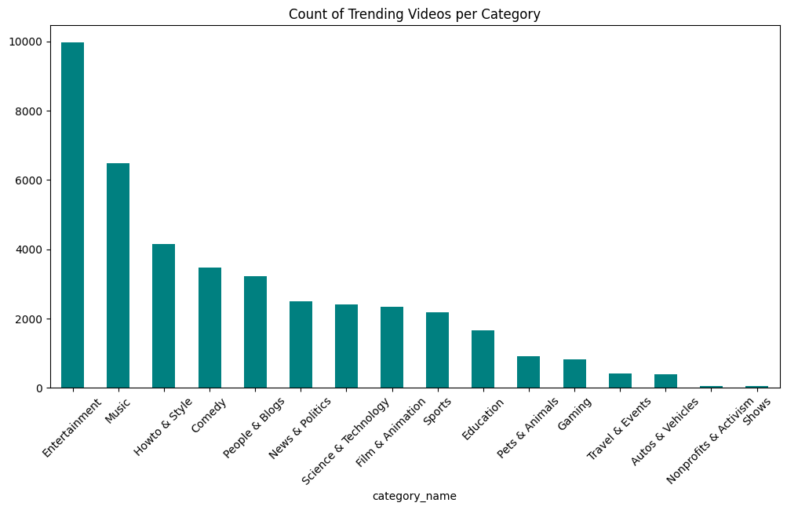
COUNT OF TRENDING VIDEOS PER CATEGORY
Bar chart shows how many trending videos belong to each YouTube category. It first sets the figure size for better readability, then uses value_counts() to calculate how often each category appears in the dataset. The results are plotted as a teal-colored bar chart, with a title added to explain the visualization. The x-axis labels are rotated to prevent overlap, and plt.show() displays the final graph. Overall, this chart helps identify which categories trend the most, making it easy to see viewer preferences and content dominance on YouTube.

Slide 7
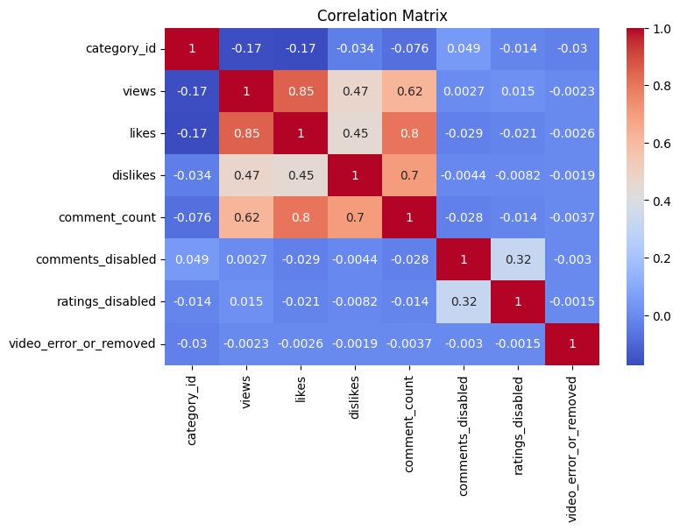
CORRELATION MATRIX
This heatmap shows the correlation between all numerical columns in the dataset. The df.corr(numeric_only=True) function calculates how strongly each numeric feature is related to the others. The sns.heatmap() function visualizes these correlations, with annot=True displaying the exact values and cmap="coolwarm" adding a color scale where warm colors show strong positive correlation and cool colors show strong negative correlation. The plot size is set using plt.figure(figsize=(8,5)), and the final heatmap is displayed with a title using plt.show(). This helps quickly identify which factors have strong relationships in the data.

Slide 8
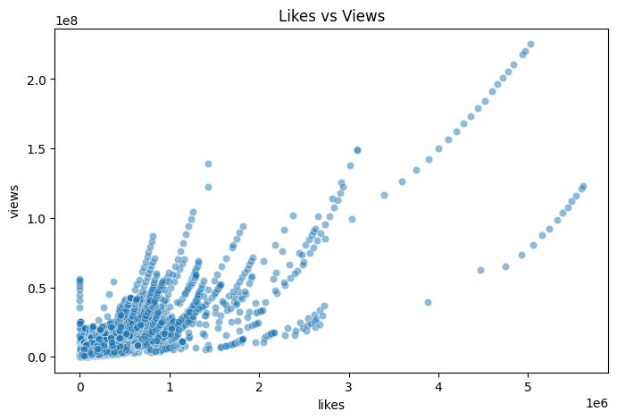
LIKES VS VIEWS
This scatter plot shows the relationship between likes and views on YouTube videos. Each point represents a video, with likes on the x-axis and views on the y-axis. The alpha=0.5 makes the points slightly transparent to reduce overlap. The figure size is set for better clarity, and a title is added before displaying the plot. This visualization helps identify whether videos with more likes generally receive more views.

Slide 9
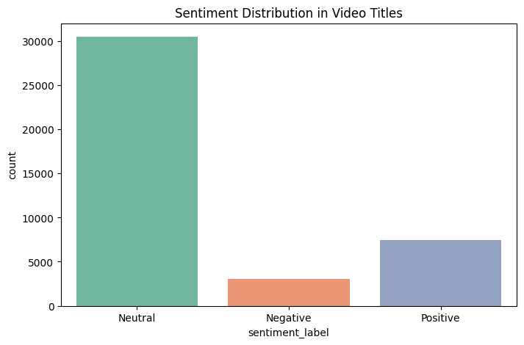
SENTIMENT DISTRIBUTION IN VIDEO TITLES
This plot shows how many video titles fall into each sentiment category (Positive, Neutral, Negative). The countplot function counts the frequency of each sentiment label, and palette="Set2" adds pleasant colors. The figure size is set for readability, a title is added, and the plot is displayed. This helps visualize the overall sentiment distribution in video titles.

Slide 10
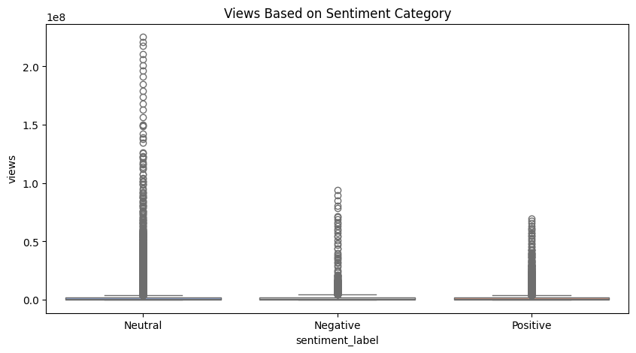
VIEW BASED ON SENTIMENT CATEGORY
This boxplot shows how video views vary across different sentiment categories (Positive, Neutral, Negative). The x-axis represents the sentiment label, while the y-axis shows the number of views. The palette="coolwarm" adds color contrast, and the plot helps compare how sentiment in video titles relates to view counts.

Slide 11
Task 3 — Visualizations
Created meaningful charts such as:
✔ Trending Videos by Day of Week
✔ Category-wise video count
✔ Top 10 Most Viewed Trending Videos
✔ Likes vs Views scatter plot
✔ Engagement rate distribution
✔ Comment count comparison
✔ Correlation heatmap
These visuals helped understand the platform’s engagement trends.

Slide 12
3.1 Analysis & Insights
3.1.1 Category Performance
✔ Entertainment dominates the trending list with the highest number of videos.
✔ Music videos generate the highest views and engagement.
✔ Sports and News trend less frequently but show high interaction during major events.
3.1.2 Views & Engagement Patterns
✔ Videos with strong viewer interaction (likes & comments) are more likely to trend.
✔ Some trending videos have millions of views but low engagement, indicating passive audiences (common in music & trailers).
✔ High engagement rate is seen in categories like Gaming, Commentary, and Vlogs.
3.1.3 Day-Wise Trending Activity
✔ Friday and Saturday show the highest number of trending uploads.
✔ Monday has the lowest trending activity.
✔ Engagement peaks during weekends.
3.1.4 Like–Dislike Ratio
✔ Trending videos generally have a high like ratio.
✔ Categories such as Politics and News show higher dislike ratios due to polarizing content.
3.1.5 Comment Behaviour
✔ Videos with more comments show higher community involvement.
✔ Music and Entertainment videos dominate comment volume.

Slide 13
Task 4: Machine Learning Model
4.1 Objective
✔ Predict video engagement (views or likes) based on metadata, category, tags, upload time, and other features.
4.2 Model Used
✔ Linear Regression and Random Forest Regressor for predicting views.
✔ Accuracy evaluated using RMSE and R² scores.
4.3 Key Features
✔ category_id, title_length, tags_count, publish_hour, days_trending
✔ Sentiment polarity score of comments
4.4 Insights from Model
✔ Category, upload timing, and title length strongly influence engagement.
✔ Videos with more positive comments tend to have higher views.
✔ Model predictions help channels optimize content strategy for better trending performance.

Slide 14
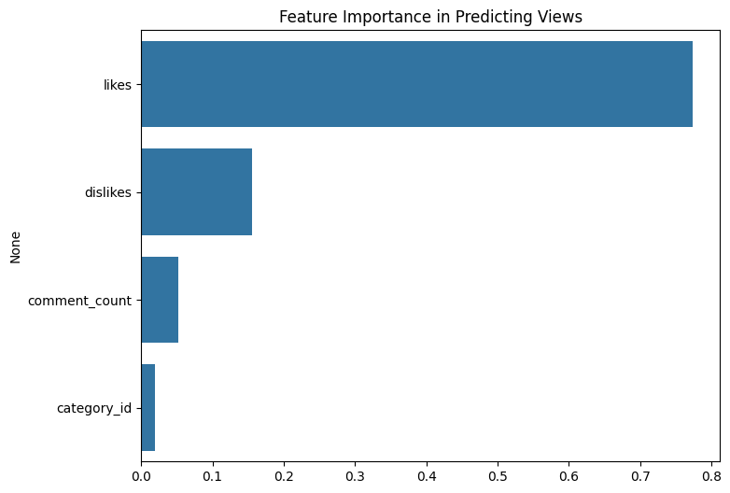
FEATURE IMPORTANCE IN PREDICTING VIREWS
This bar chart shows how important each feature is in the machine learning model used to predict video views. The x-axis displays the feature importance scores from the model, and the y-axis lists the feature names. This visualization helps identify which factors (like likes, comments, category, etc.) contribute most to predicting a video's views.

Slide 15
RECOMMENDATIONS
Post on high-engagement days (Friday–Sunday) to increase the chances of trending.
Prioritize categories like Entertainment, Music, and Gaming, which consistently dominate trends.
Use strong titles, relevant tags, and clear descriptions to improve search and recommendation visibility.
Encourage engagement through comments, likes, and community interactions.
Analyze viewer feedback to understand audience preferences and refine content strategy.
Leverage trending topics and events for timely and relevant content boosts.

Slide 16
CONCLUSION
This project analyzed YouTube trending videos using views, likes, comments, categories, channels, and sentiment patterns. Key insights include:
✔ Positive comments dominate, reflecting overall viewer satisfaction.
✔ Engagement depends on content category, upload timing, and channel influence rather than just subscriber count.
✔ Machine learning models help predict potential trending success, providing actionable strategies for creators.
✔ Overall, data-driven content optimization, audience engagement understanding, and predictive modeling can significantly improve YouTube performance.

Slide 17
THANK YOU

